Slide 1
Retrieval 1/2
BDK10-5 | Information Retrieval
William Hersh, MD | Department of Medical Informatics & Clinical Epidemiology
Oregon Health & Science University

Slide 2
Retrieval
Two general approaches – used to be mutually exclusive but most modern systems make use of both, e.g., PubMed and Google
Boolean, set-based, exact-match
Natural language, automated, partial-match
Early systems tended to be Boolean
Preferred by power users?
More recent systems based on natural language
Simpler for less experienced searchers?

Slide 3
Boolean retrieval
Basic approach
Build sets of content items (i.e., documents) based on search terms from controlled vocabulary or text words
Combine with AND, OR, NOT
Most bibliographic systems use Boolean operators
Allow searching on both assigned indexing terms and text words
Systems retrieving other types of content use them too, though they are sometimes hidden, e.g., Google performs AND of all words in query

Slide 4
Boolean operators
AND – only content items that have all terms
OR – content items that have any term
NOT – content items with one term but not other

Slide 5
Some advanced features of Boolean systems
Proximity operators require words to be within a certain range
e.g., colon (4) cancer, “colon cancer”
Explosions perform OR down a hierarchy
PubMed “autoexplodes” many MeSH terms, e.g.,
All diseases in a category, e.g., anemias
All drugs in a certain class, e.g., ACE inhibitors
Subheadings refine a heading
e.g., diagnosis of hypertension

Slide 6
PubMed
NLM system for searching MEDLINE and related databases
Includes some OLDMEDLINE (before 1966) as well as other records not indexed in MEDLINE
Based on Boolean heritage but has added a number of features of natural language searching over the years
Search algorithm tries to map input to MeSH terms, author name, and other phrases
Has traditional Boolean set capability in Advanced interface but essentially unnecessary now
Default output order is reverse chronological but can also “Sort by Relevance”

Slide 7
Other valuable features of PubMed
Spelling correction
Graphical interface for applying limits
Link Out to full text (and other resources)
Link to publisher site, may not be free
Clinical Queries
Help find best evidence for EBM question types
MyNCBI
Allows saved searches, custom filters, emailing of results, etc.

Slide 8
Let’s take a tour of PubMed
User wants to know about treatment of congestive heart failure with angiotensin-converting enzyme (ACE) inhibitors
PubMed maps query into appropriate Boolean statement
Simple AND yields way too many results, so want to narrow down, especially to best evidence
Done by applying Limits or using Clinical Queries

Slide 9
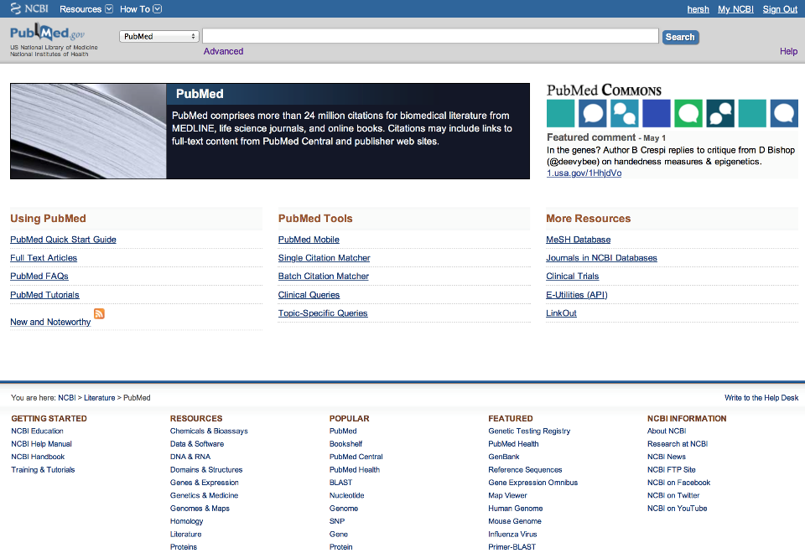
Navigating to pubmed.gov

Slide 10
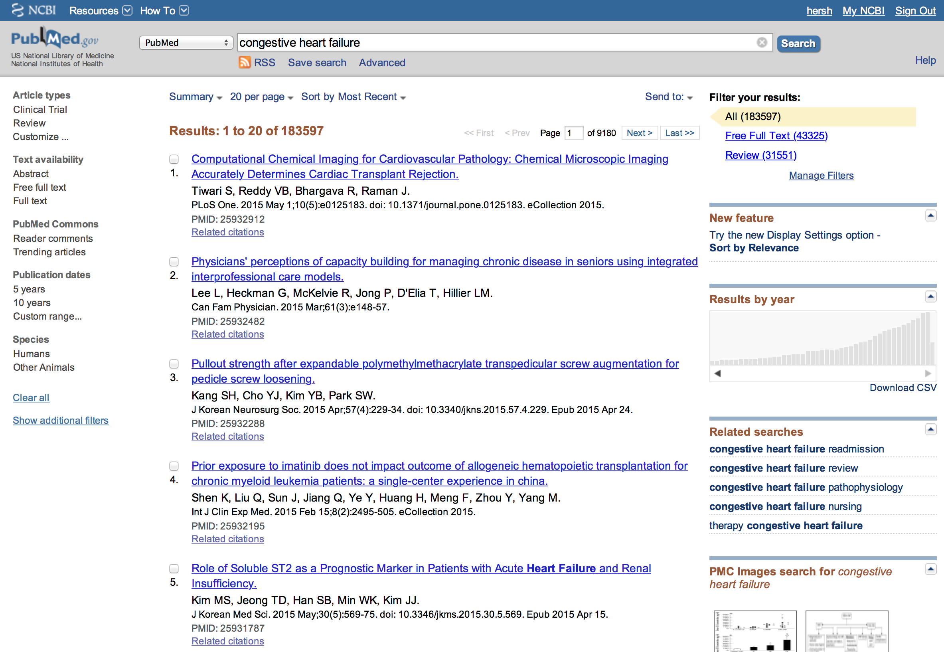
Search on CHF – note features

Slide 11
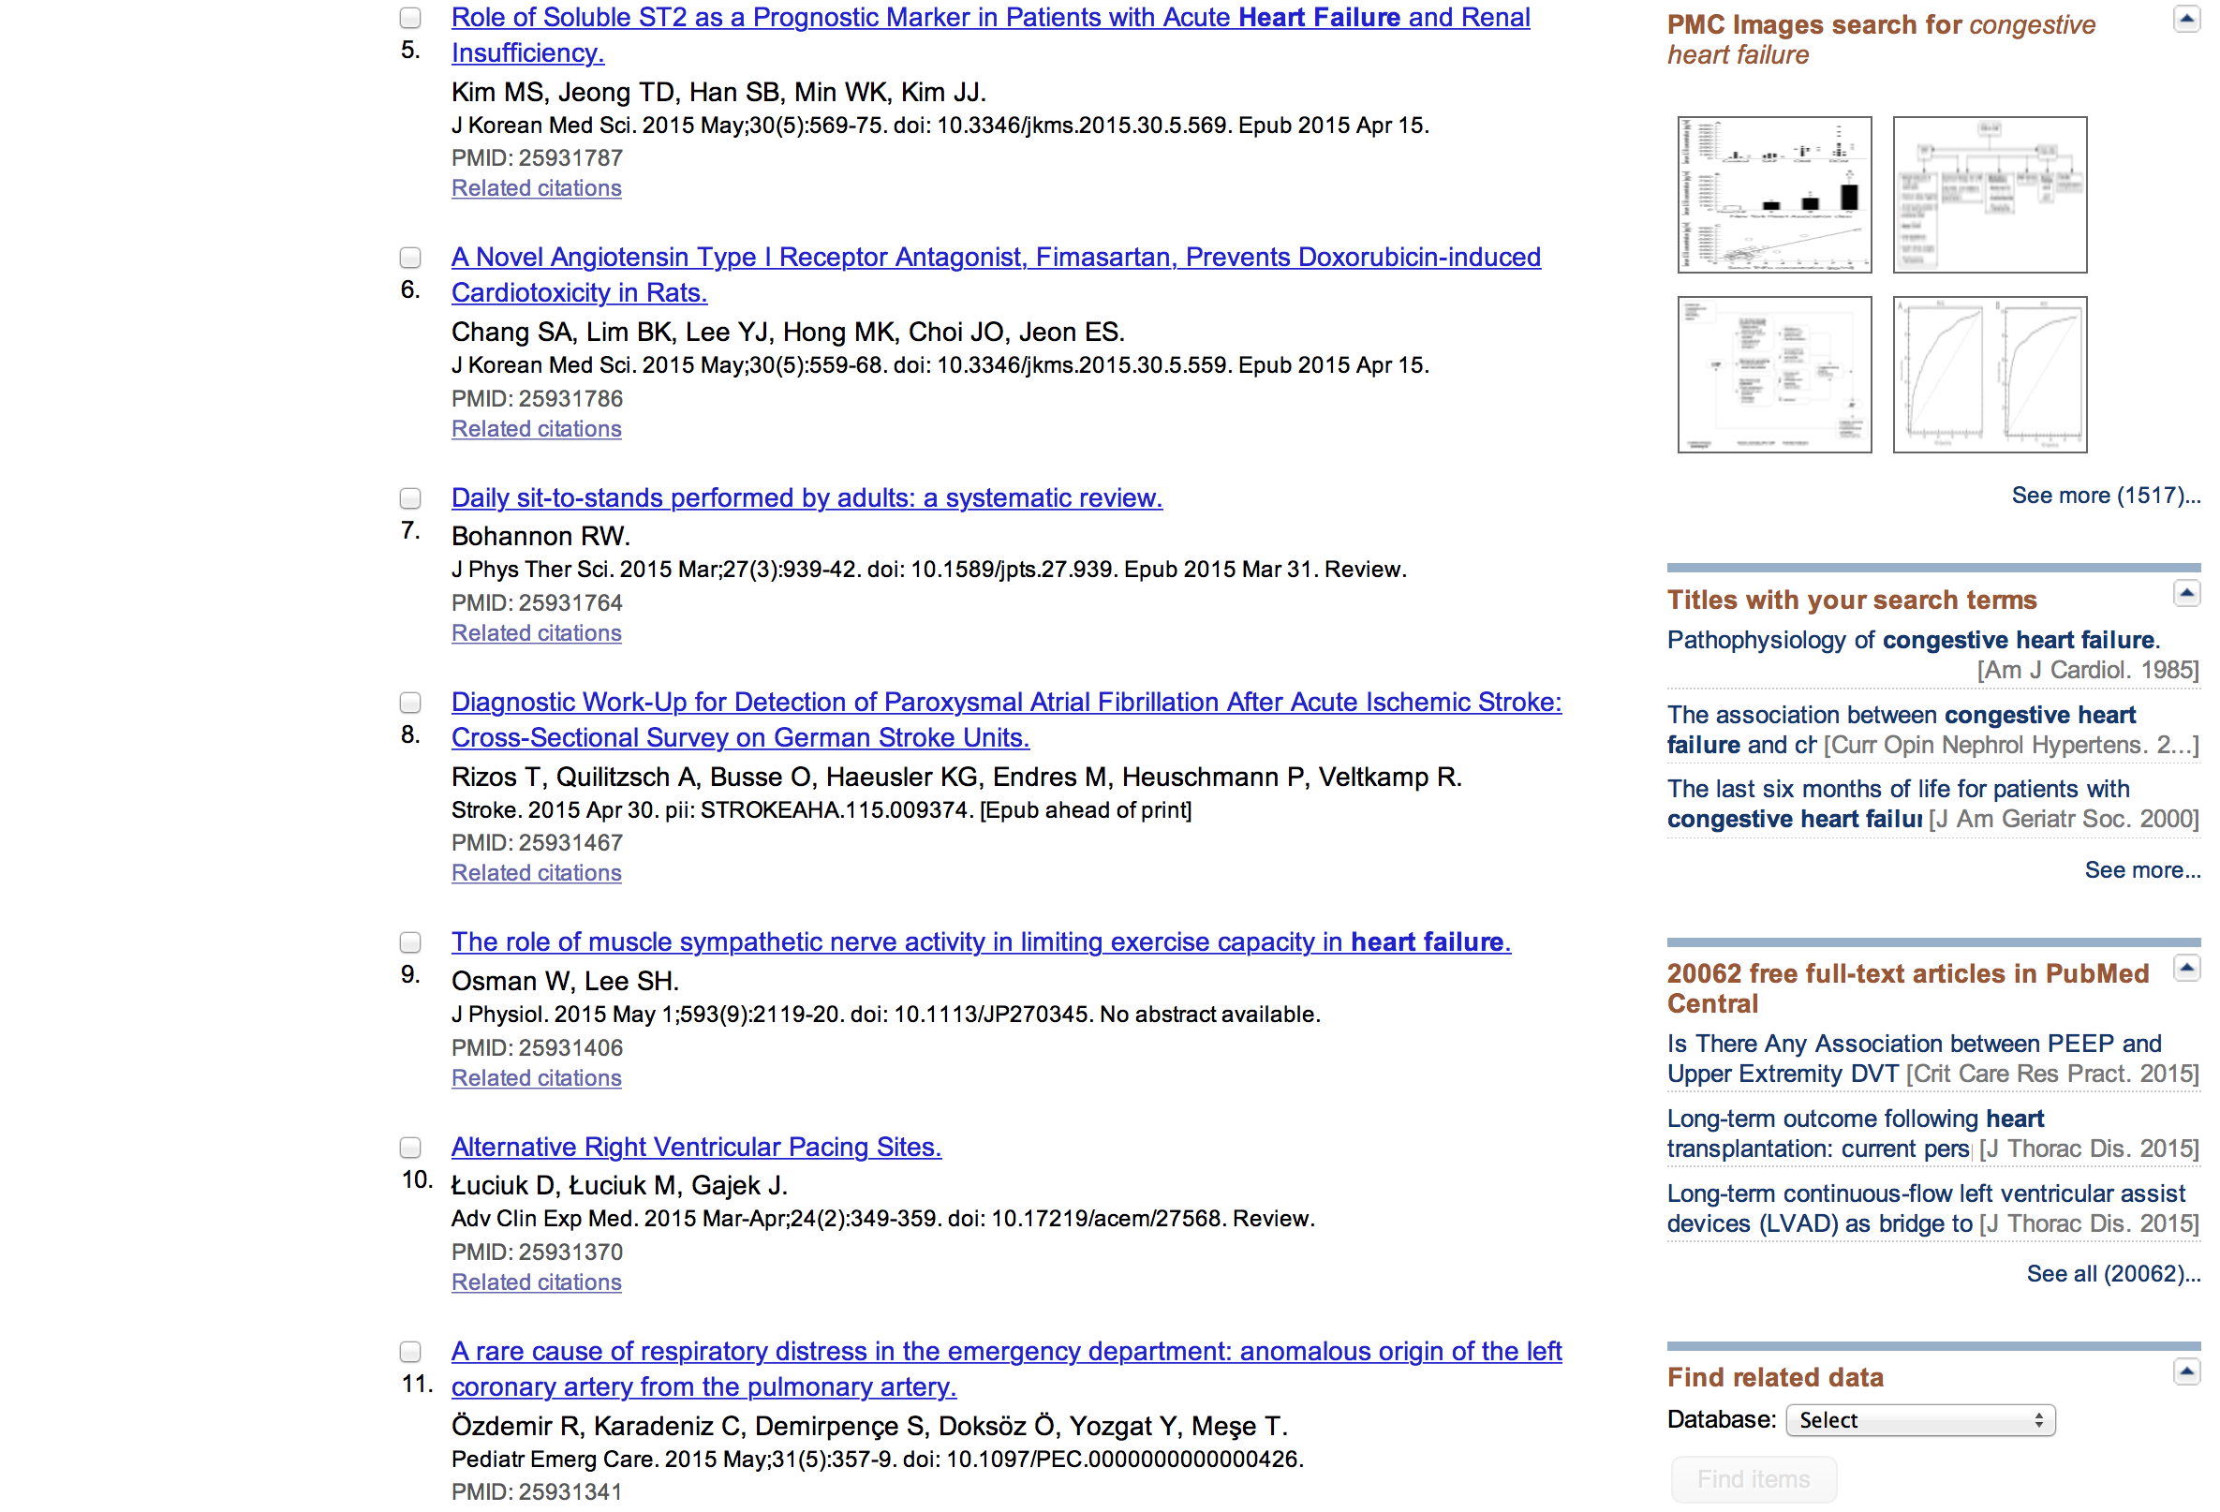
And more features

Slide 12
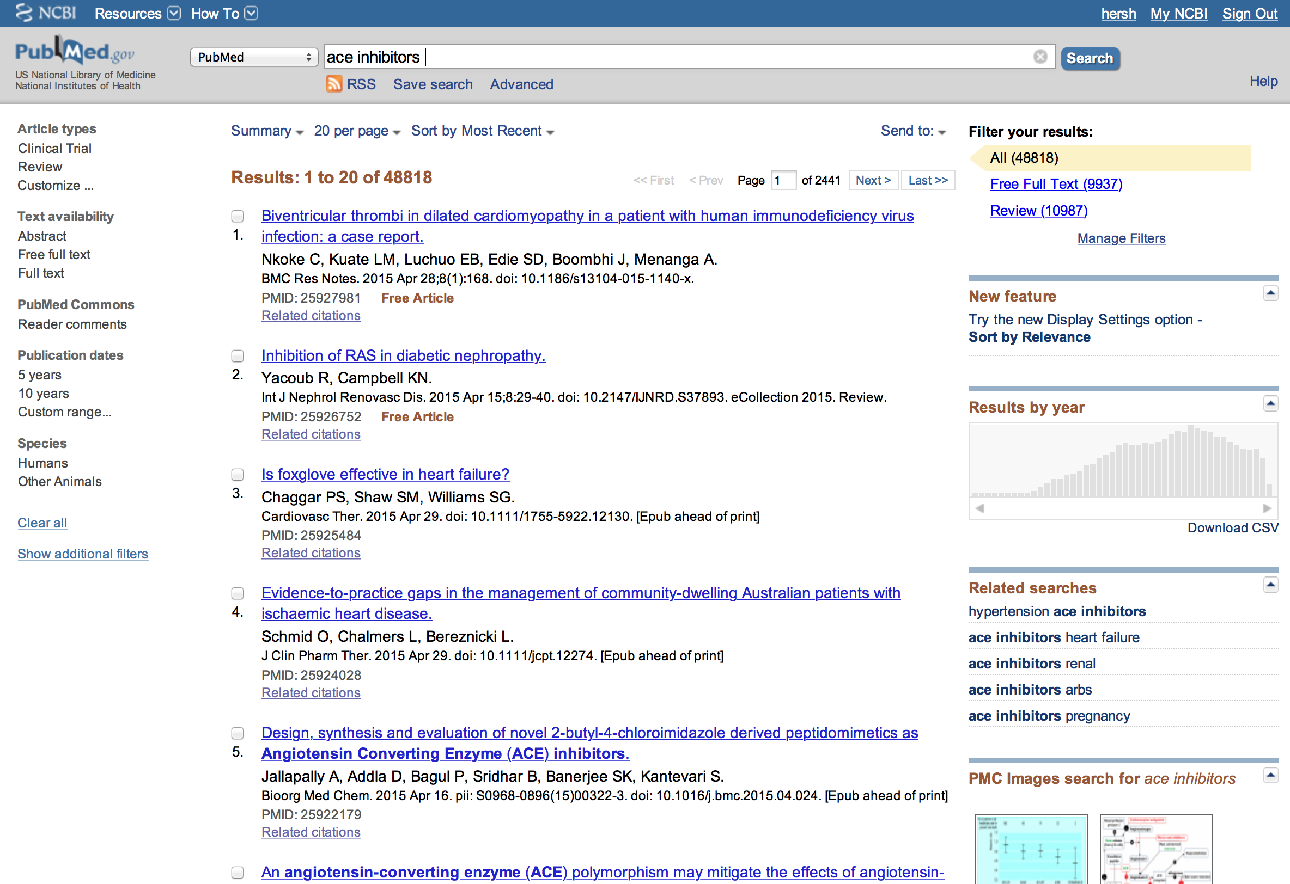
Search on ACE inhibitors

Slide 13
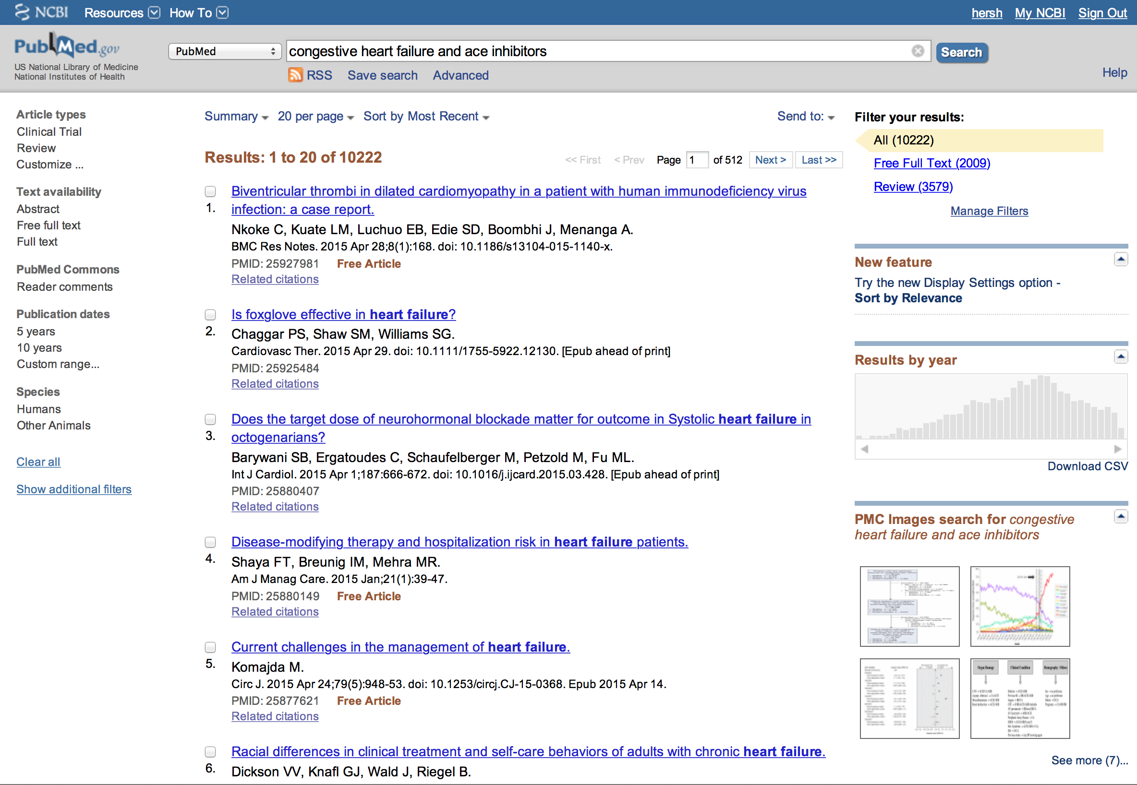
Need to and these, but still too many

Slide 14

What if you forget the and?

Slide 15
How did it do that?
PubMed mapping determines terms and appropriate Boolean operators, e.g.,
“congestive heart failure ace inhibitors” becomes:
("heart failure"[MeSH Terms] OR ("heart"[All Fields] AND "failure"[All Fields]) OR "heart failure"[All Fields] OR ("congestive"[All Fields] AND "heart"[All Fields] AND "failure"[All Fields]) OR "congestive heart failure"[All Fields]) AND ("angiotensin-converting enzyme inhibitors"[MeSH Terms] OR ("angiotensin-converting"[All Fields] AND "enzyme"[All Fields] AND "inhibitors"[All Fields]) OR "angiotensin-converting enzyme inhibitors"[All Fields] OR ("ace"[All Fields] AND "inhibitors"[All Fields]) OR "ace inhibitors"[All Fields] OR "angiotensin-converting enzyme inhibitors"[Pharmacological Action])

Slide 16
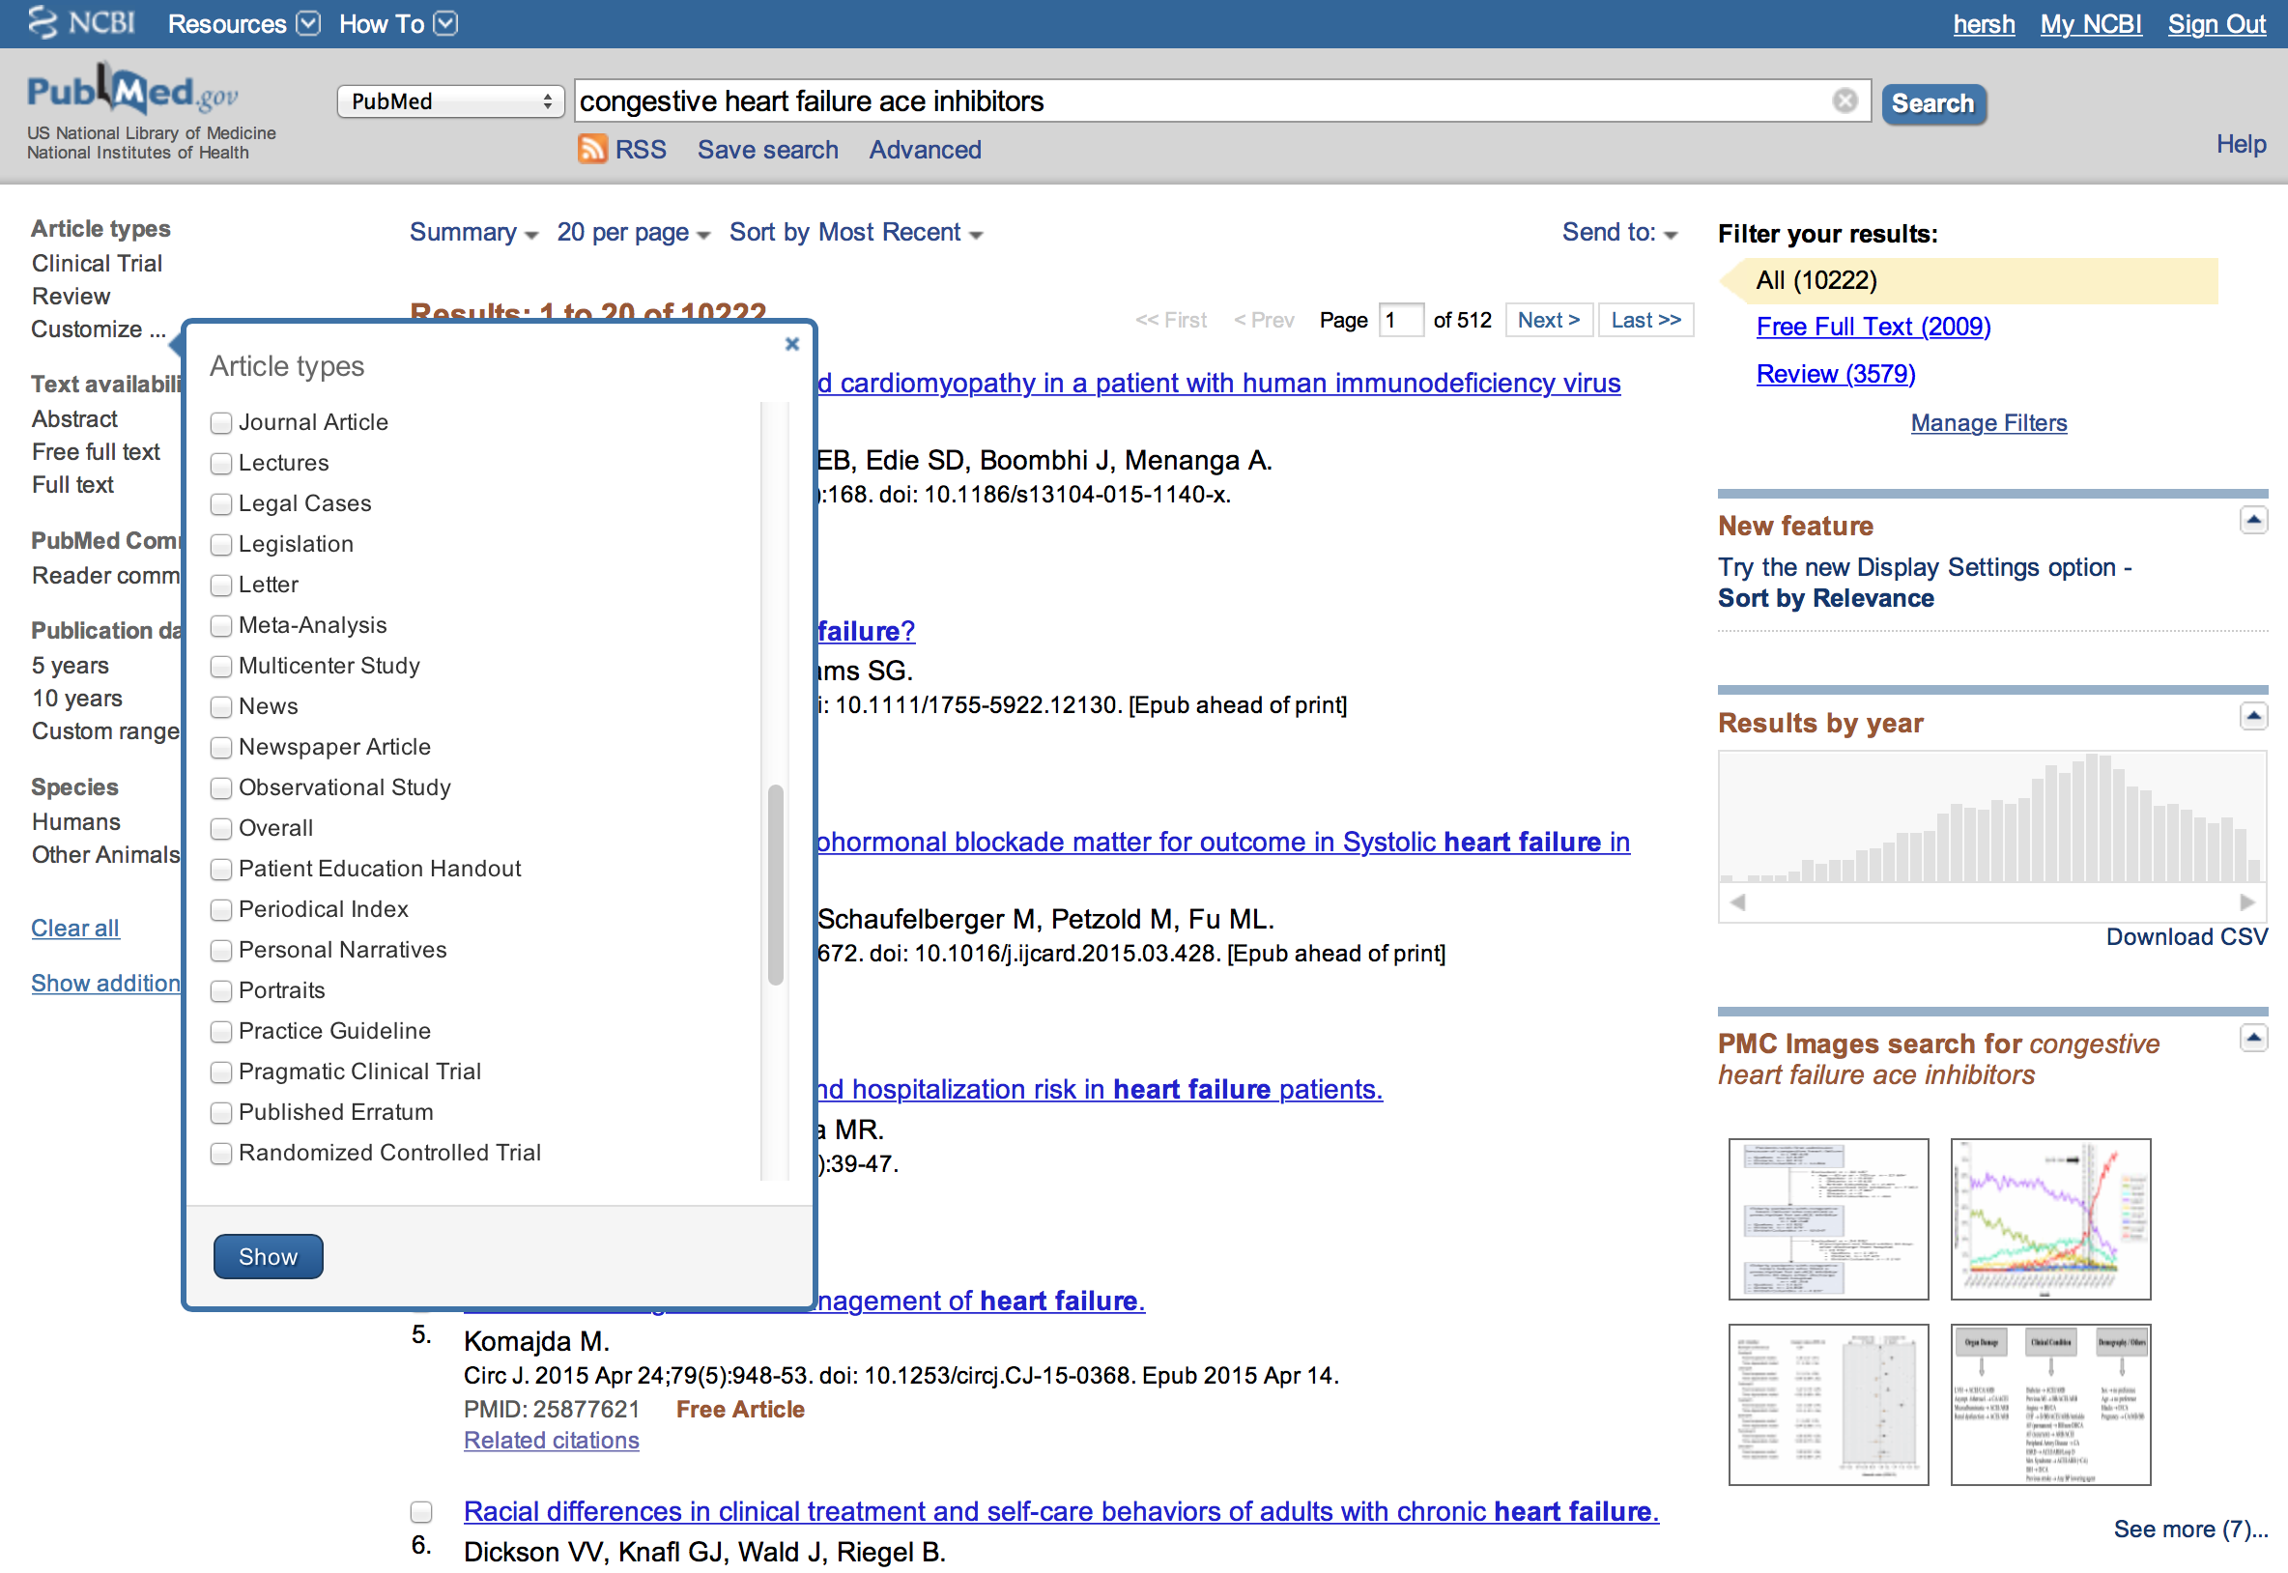
But 10,000+ is still way too much

Slide 17
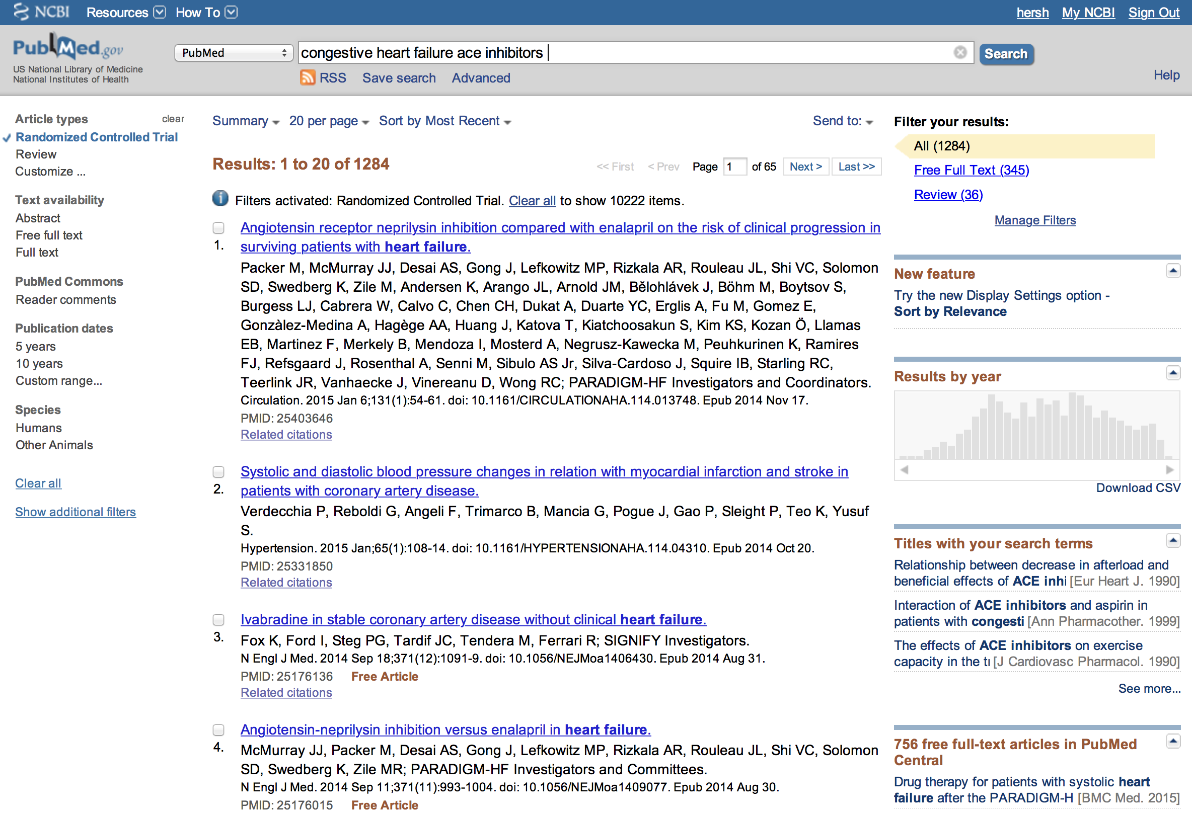
So can limit by RCT

Slide 18
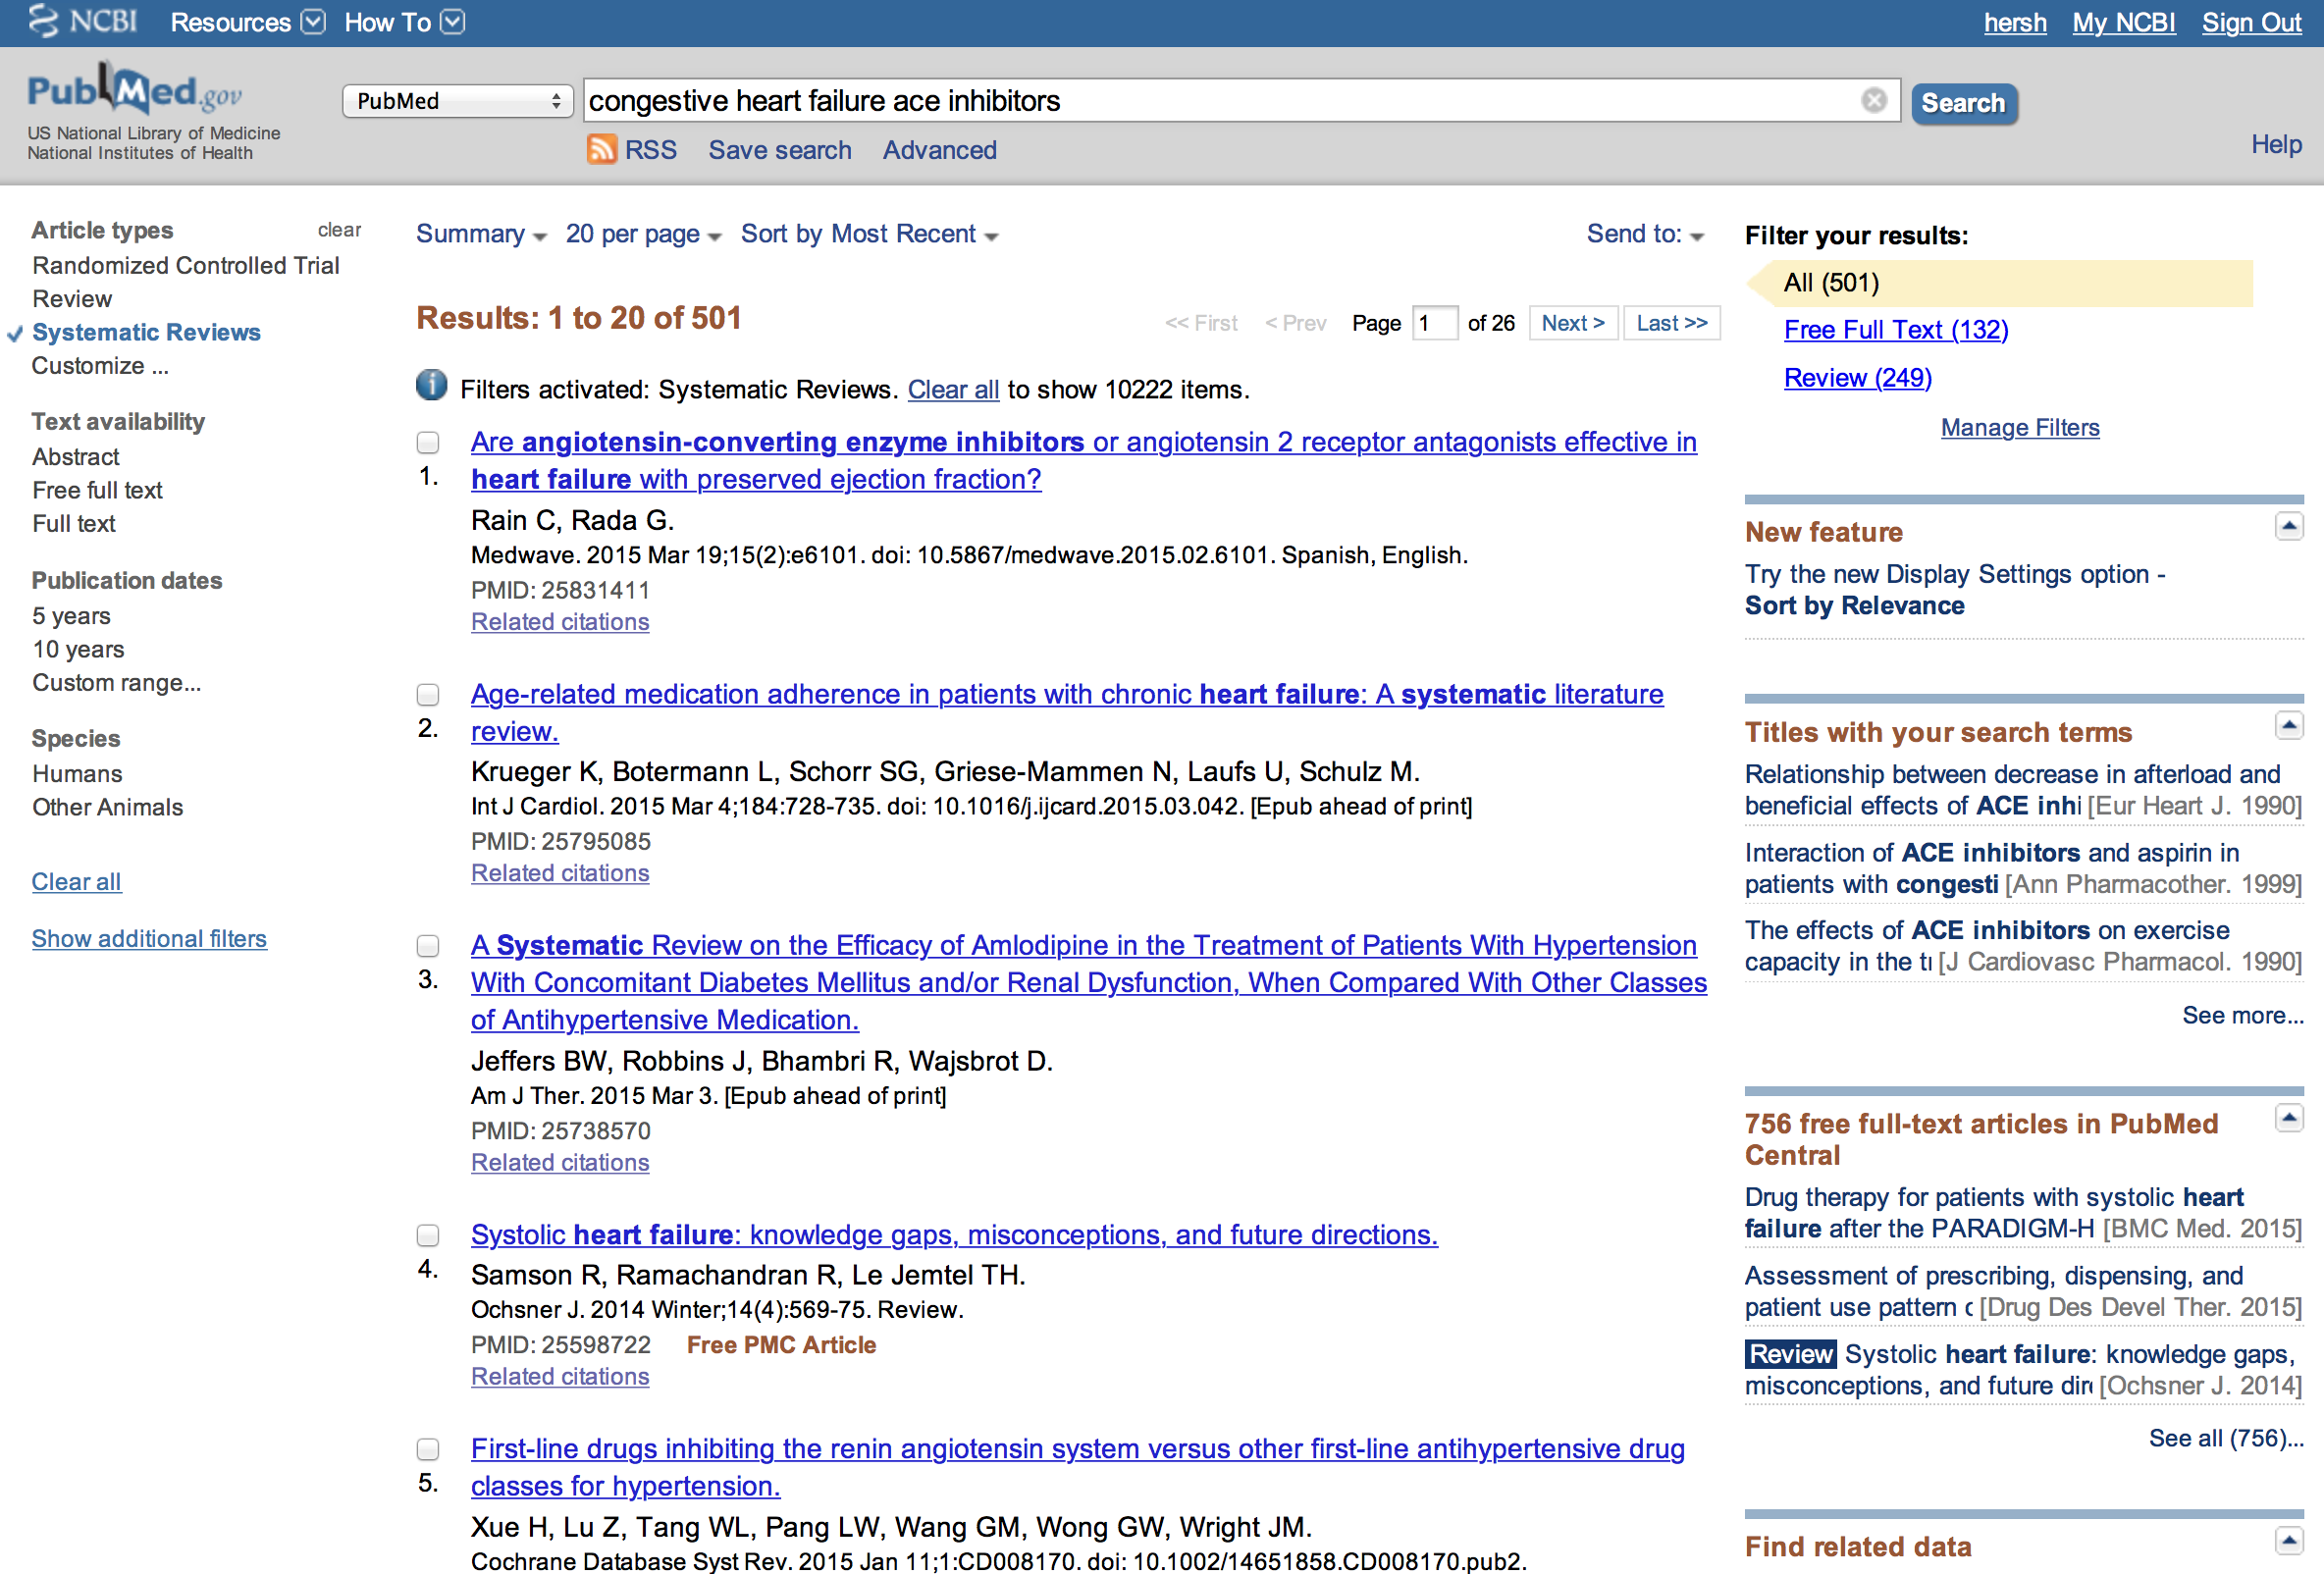
Still too many, so use other limits

Slide 19
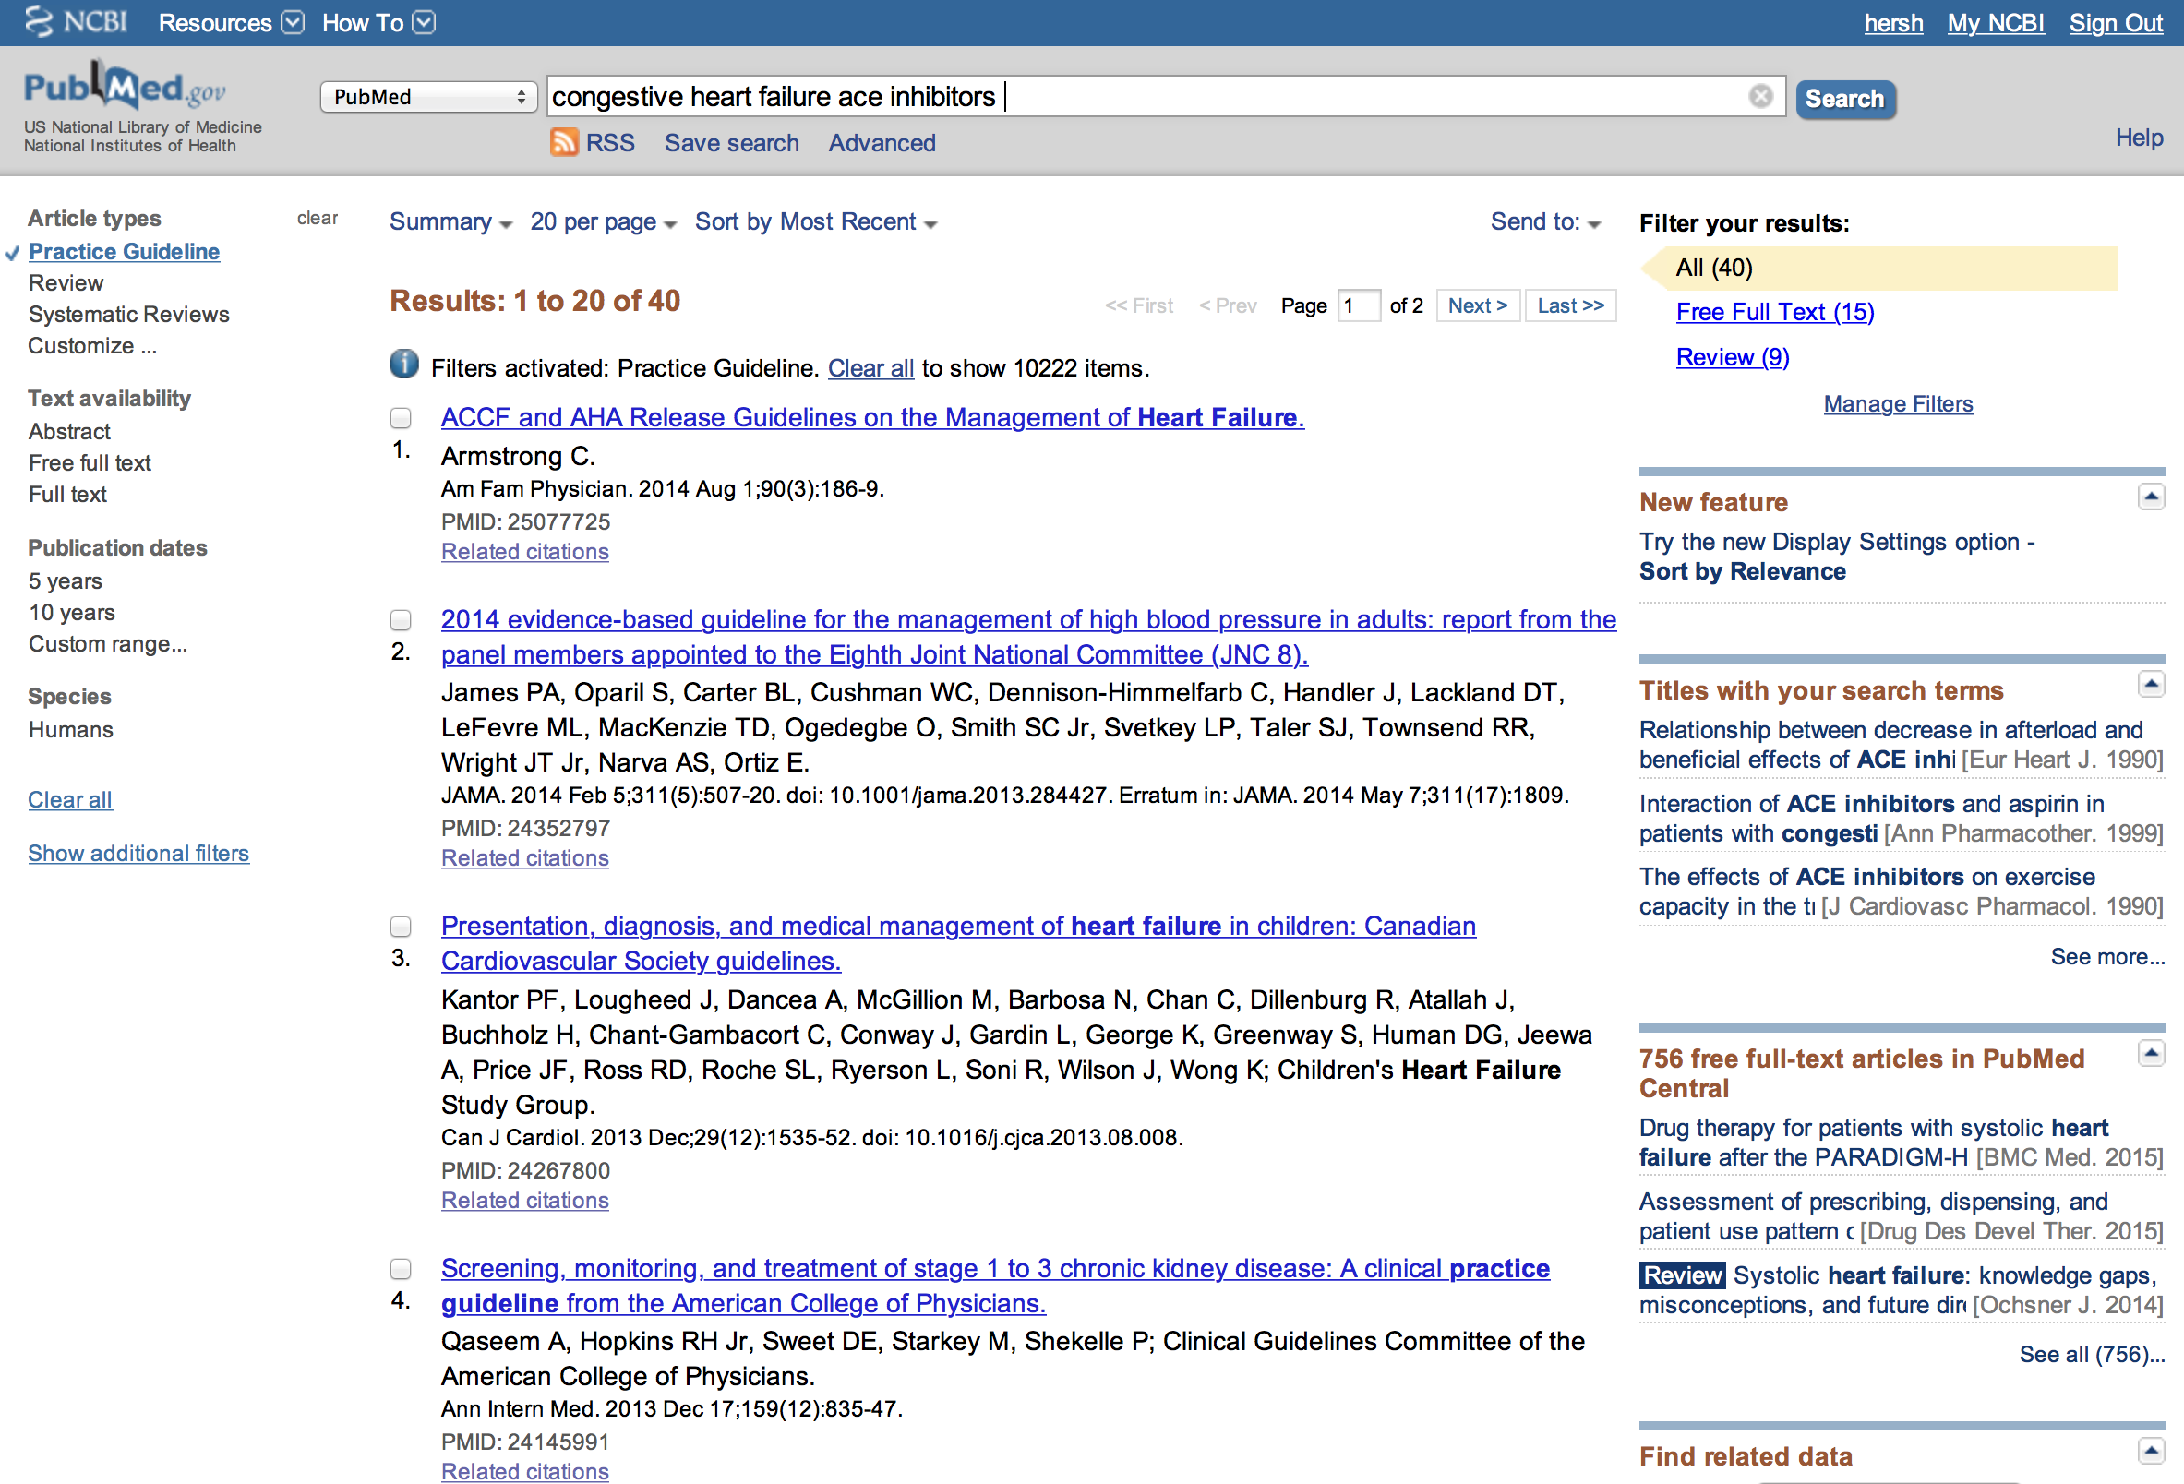
Or further limits

Slide 20
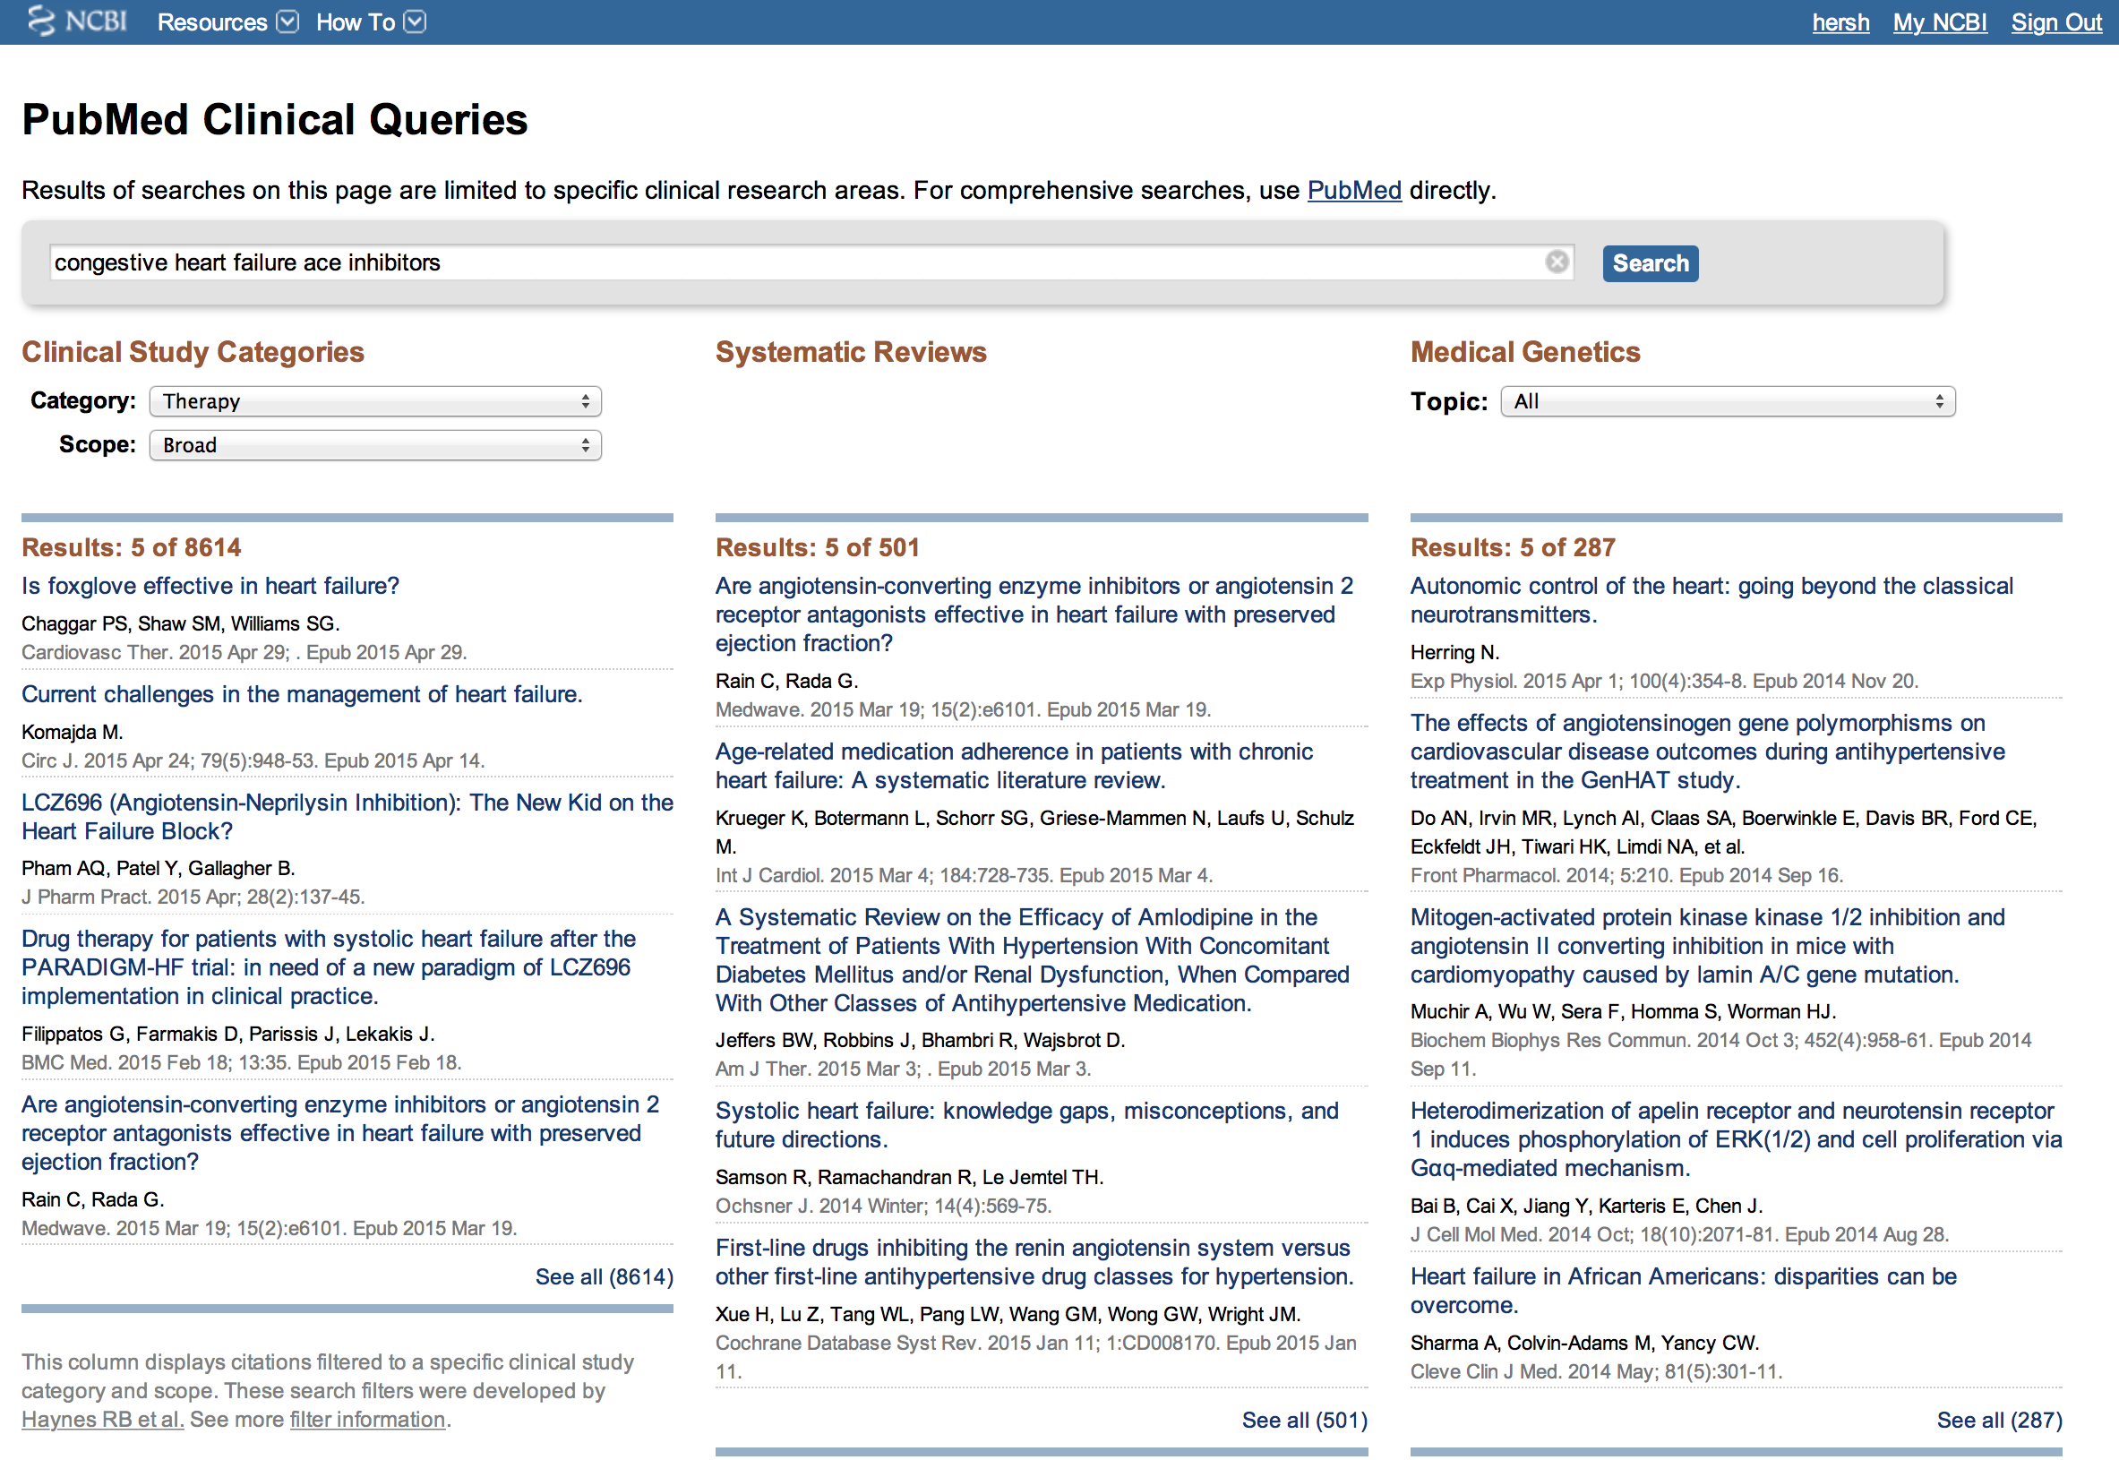
Another option is Clinical Queries

Slide 21
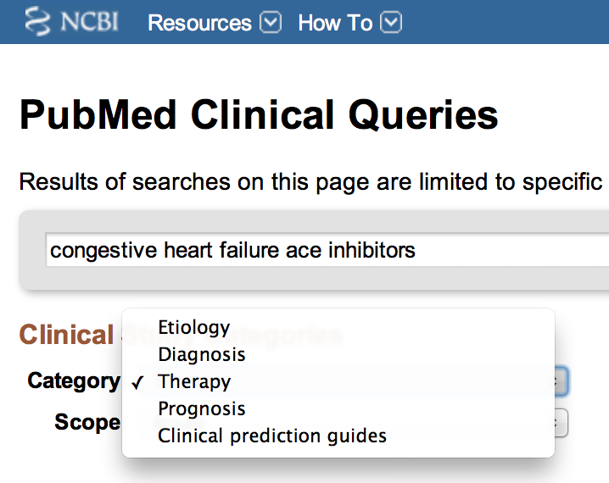
Clinical Study Categories allows different EBM question types

Slide 22
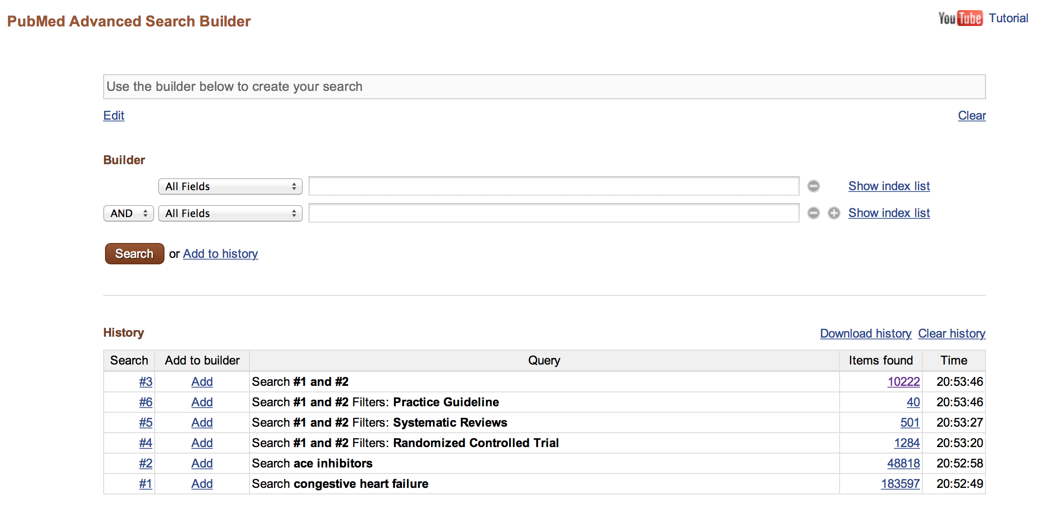
Also features “advanced” search

Slide 23
Thank you
Please download the resource list with useful links from the “Resources” tab in the upper right of the player.
This course was made possible under a grant from the NIH (# 1R25GM114820-01)

